Slide 1

Research Overview
Yuyang Wang
Postdoctoral Research Scientist, Columbia Nano Initiative
Columbia University in the City of New York, New York, NY 10027
🖂 yw3831@columbia.edu
March 11, 2025

Slide 2






PhD at UC Santa Barbara – Electronic-Photonic Design Automation
Runtime reconfiguration adaptive to application demands
System level
Cadence-Lumerical Interoperability
Cadence CurvyCore Layout (Intern 2018)
E-O co-simulation, layout, and variation mitigation
Link level
Compact modeling
Variation characterization
Device level
Measurement data of fabricated devices and test structures
Notes:
I got my PhD from UC Santa Barbara, and it was at a time when silicon photonic devices have emerged with both diversified functionalities and some good performance. But there lacked an efficient way of designing photonic circuits using these devices, especially when you want to co-simulate them with electronic drivers and to also account for fabrication process variations during the design stage.
So the main focus of my PhD work was to bring in the decades of experience from the EDA domain, and of course adapt them to some unique challenges of photonics design, to enable the design automation of large-scale photonic integrated circuits.
As I am showing here, the approach that I took really based on measurement data from fabricated devices, and encompassed several design phases from simulation, to layout, and to applications in data communication systems. And some of the methodologies were actually adopted by the industry, like using Verilog-A models for electronic-photonic co-simulation, and being able to generate curved layouts in traditional EDA tools like Cadence.

Slide 3
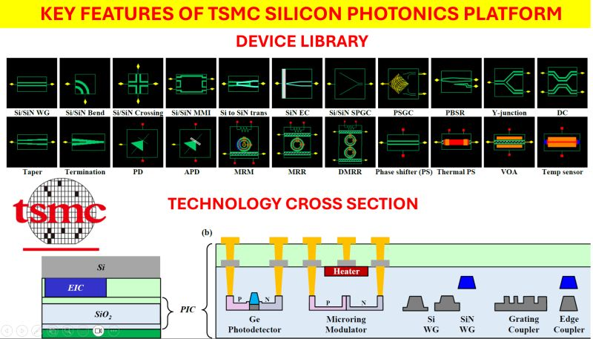
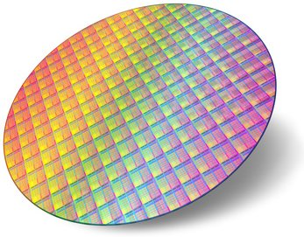



Seeing the Maturing of Silicon Photonics Foundry Services
300 mm SOI Wafers
Notes:
And after I came to Columbia for my postdoc, I took a bit of a shift in my research focus, because I recognized the rapid emergence of foundries that offer silicon photonics wafer runs, like AIM Photonics, GlobalFoundries, and TowerJazz, and recently TSMC, just to name a few. So it was really a great time to make use of these offerings and really demonstrate some applications of silicon photonics in computing systems that are only possible by integrating thousands, or even tens of thousands, of photonic devices on a single chip.

Slide 4
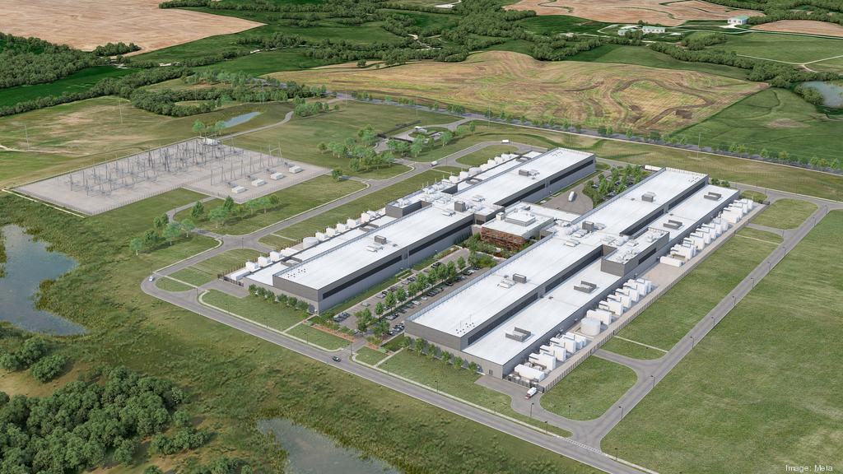

Computing at Scale = Computation + Communication
Notes:
So, one of the scenarios that I mainly looked at is these large-scale compute clusters where data now has to travel longer distances, like meters to hundreds of meters, because the workloads are so large and they have to be distributed. And electrical interconnects are struggling to carry data over these distances with high bandwidth and low energy.

Slide 5
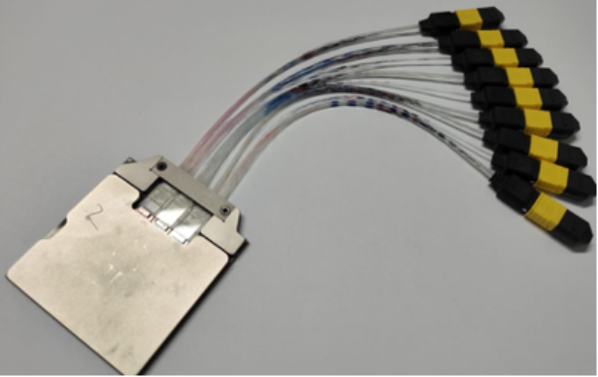
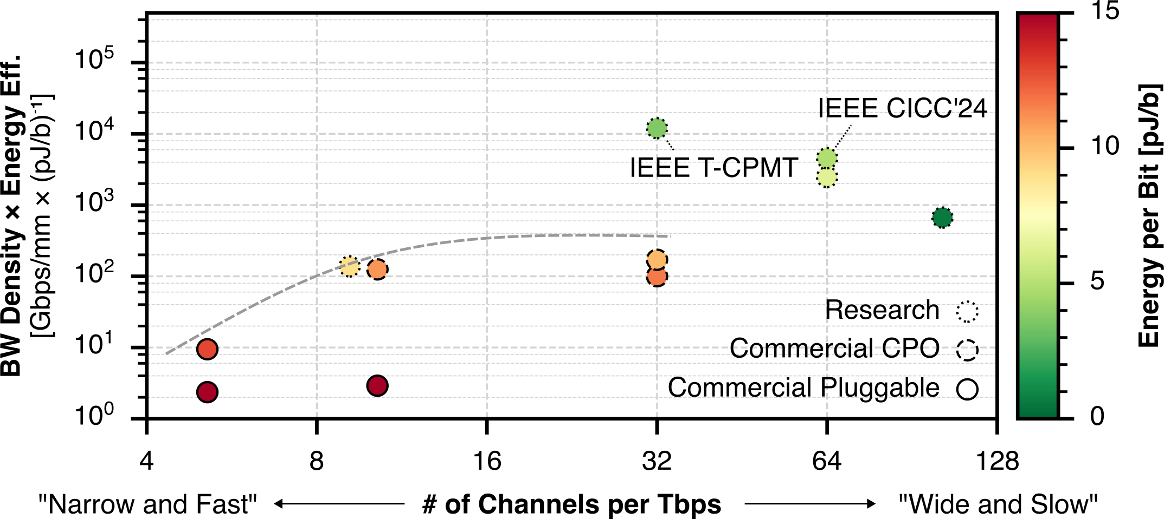
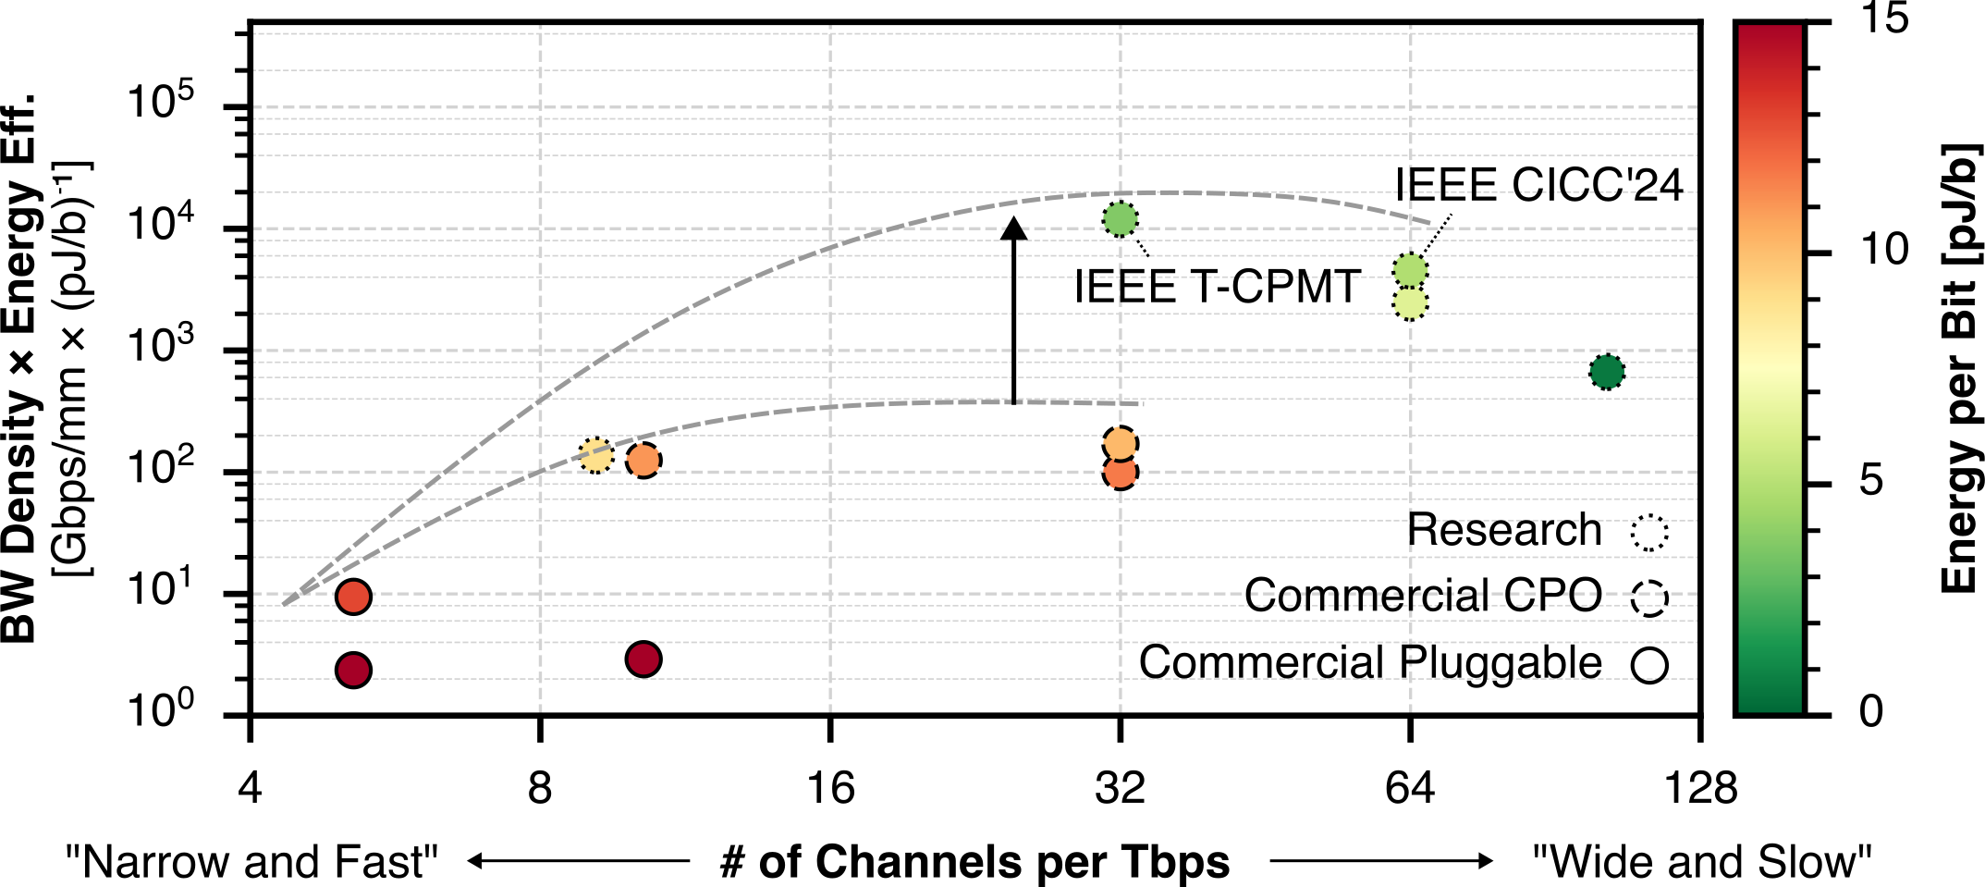
Co-Packaged Photonic Data I/O
100x
Prior work
96 Tb/s bidirectional
4 Tb/s/mm shoreline
< 1 pJ/b energy
Notes:
So, this was the main research outcome, which was achieved under the DARPA PIPES program in phase 2 and is now in phase 3. This is a multi-chip package that delivers a 96 Tbps bidirectional bandwidth with a 4 Tbps/mm bandwidth density, right to the edge of the compute chip at an energy cost of less than 1 pJ/b. And this represents a two-order-of-magnitude improvement over the state-of-the-art if you look at the bandwidth density and energy efficiency combined.

Slide 6
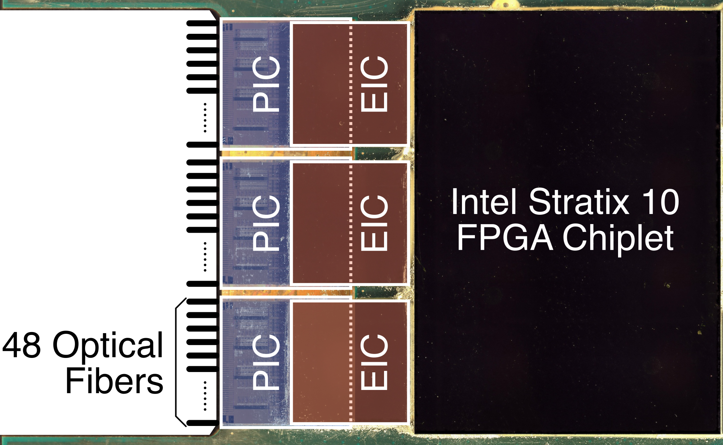
Under the Hood – Hybrid 2.5D/3D Integration
PIC: My work
EIC: Cornell
Package: Intel
Notes:
And under the hood you can see it was really a highly collaborative work between academia and industry, where I designed these three photonic chips here that are 3D-integrated with these Cornell electronic chips through flip-chip bonding, and further co-packaged with an Intel FPGA chip through Intel’s EMIB technology.

Slide 7
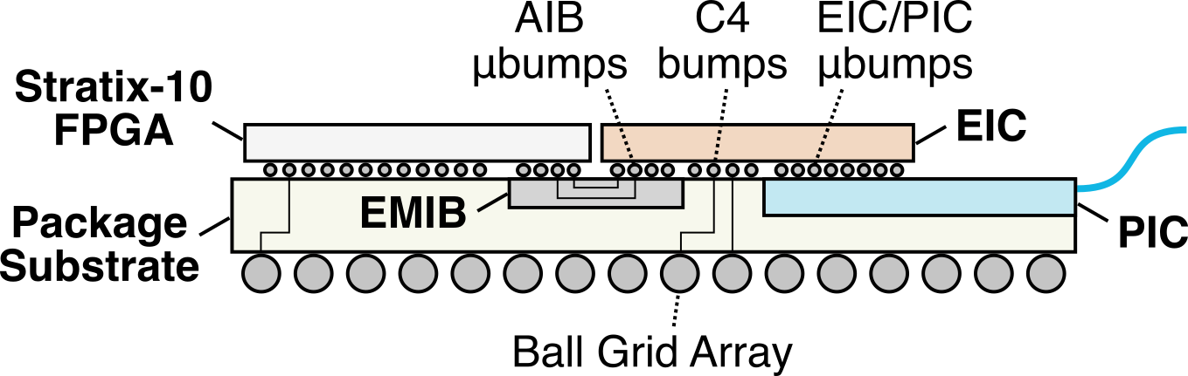
Package Cross Section
Notes:
Here is a more detailed cross-section view of the package, where the photonic chip sits in an open cavity to be flip-chip bonded with the EIC.

Slide 8
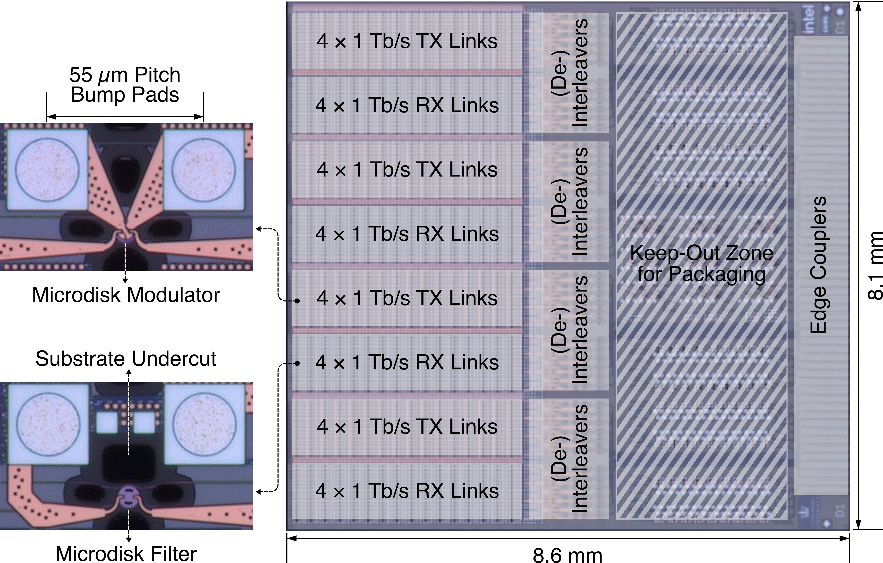
Photonic Chip Design for Packaging
Notes:
And here’s a more detailed view of my photonic chip design which integrates more than 2,000 microresonator devices per chip. What I really wanted to emphasize is that this really went through a great amount of co-design with the electronics for flip-chip bonding, and was also designed with packaging in mind, as you can see from the floor plan.

Slide 9
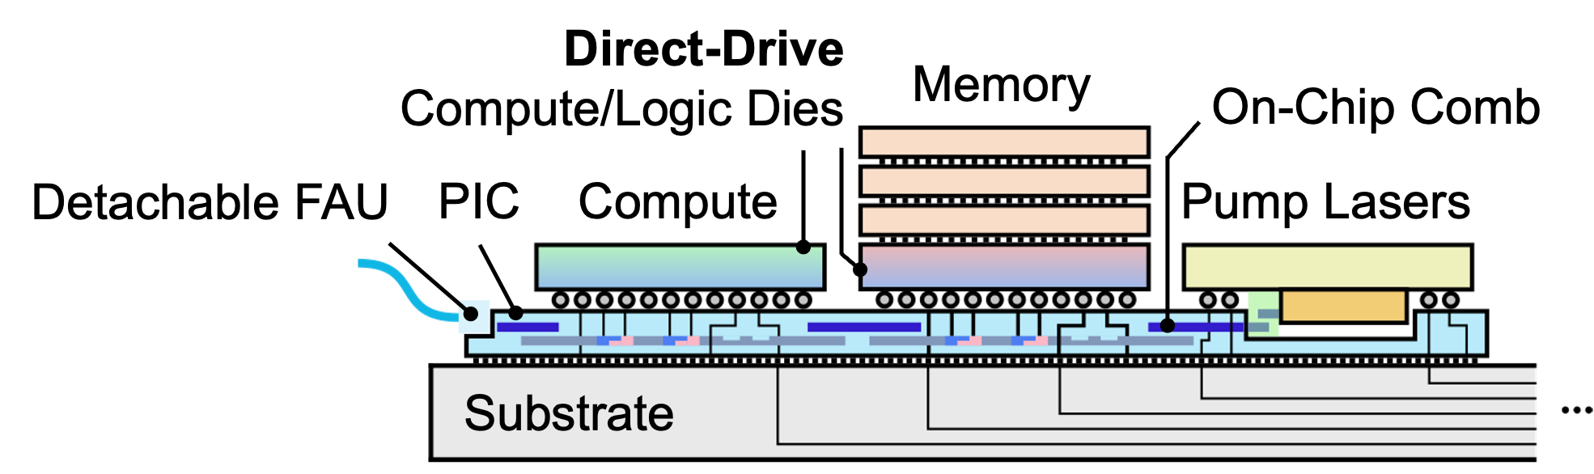
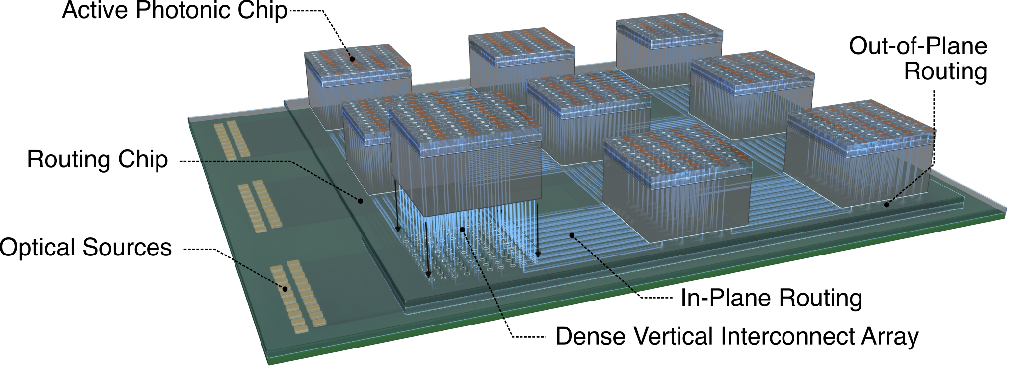
Future Directions
Heterogeneous Integration
Integrated comb source
Direct-drive photonics
3D Photonic Connectivity
Break planar photonics limitations
New paradigm for chip-to-chip connectivity
System Applications
Wafer-/Panel-scale computing
Photonics-enabled computing
Diverse application, e.g., RF antenna arrays
Notes:
So, looking forward, I am really excited about using more heterogeneous integration and advanced packaging to demonstrate new system architectures leveraging integrated photonics. For example, in this vision, I imagine a compute node with an integrated laser, and with photonic components directly driven by the compute or memory chip.
We can even think a step further, and to explore the possibility of doing optical routing in the 3rd dimension, to really break away from the density limitations of today’s planar optical routing, and to enable a new type of chip-to-chip connectivity using a large photonic substrate. Here we can also imagine perhaps using a glass substrate for optical connectivity.
From the application point of view, I think these integration and packaging schemes can be very useful for enabling wafer-scale or panel-scale computing, or for using photonics for both data communication and near-data computation, and perhaps find new applications of integrated photonics in, for example, large-scale distributed antenna arrays with photonic backends. And tying back to my PhD work, I am also interested in developing credible models, or now they like to call it digital twins, of the entire integration and packaging process, thermal and mechanical environment in the package, to enable more efficient and optimized designs.
With that, I would like to pause here and take any questions you may have.

